Slide 1
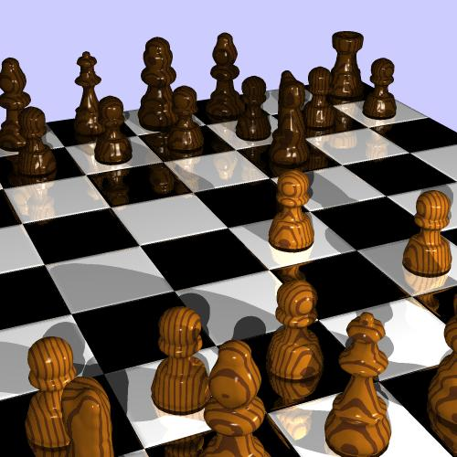
Developing Lesson Plans for a College Course A Guide for New Instructors
Three roles that a college teacher takes on:
Planner
Connector
Evaluator
vg.swan.ac.uk/ allery/AW/Chess.jpg

Slide 2

Planning
This presentation will focus on the planning process needed to develop meaningful, effective lessons that help students meet the learning outcomes of the course.
www.geniusdv.com/.../planning-thumb-320x326.gif

Slide 3
Step One
Identify all of the content, skills, behaviors and thinking processes that you want the students to learn.
Possible Sources
curriculum guide
previous instructors syllabi
discussions with other instructors
textbooks
self expertise
industry standards
licensure exams

Slide 4
Step Two
Make a list of the topics, ideas, concepts, skills and behaviors you think need to be taught

Slide 5
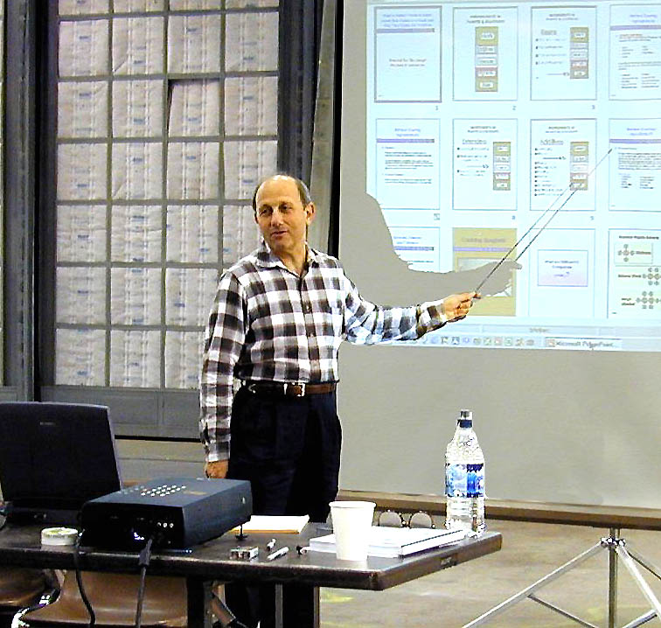
Step Two-- A
Refine the list to include only those areas that are most important
www.ronjoseph.com/Pictures/ Ron%20Lecturing%20...

Slide 6
Step Three
Take each topic, idea etc. and place them into major categories that represent their overall concept.
Example – Teaching Reading in the Content Areas
Major Categories–
1.The Reading Process
2. Reading Guides
3.Reading Disabilities
4. Reading for Main Ideas
Example- Teaching the Civil War
Major Categories –
State of the Nation leading up to the Civil War
Causes of the Civil War
North’s Strategies
South’s Strategies
Turning Points

Slide 7
Step Four Develop Learning Outcomes
From these major categories write a set of learning outcomes for the course—most courses have 6- 8 learning outcomes.( How to write outcomes is explained in the next few slides)
Learning Outcomes have four (4) parts
Who will do the learning?
When will the learning be completed?
What will they learn?
How will you know that they learned it?

Slide 8
Learning Outcomes
When Who
Example
By the end of the semester students will demonstrate through their written work and class presentations how to apply reading guides to a content textbook
What Know they Learned

Slide 9
Learning outcomes provide direction in the planning of a learning activity
They help to:
Focus on learner's behavior that is to be changed
Serve as guidelines for content, instruction, and evaluation
Identify specifically what should be learned
Convey to learners exactly what is to be accomplished

Slide 10
What are the characteristics of learning outcomes
Learning outcomes have three distinguishing characteristics.
The specified action by the learners must be observable.—writing, talking, drawing, dancing
The specified action by the learners must be measurable.
The specified action must be done by the learners.

Slide 11
How do you fix an unclear outcome?
Many syllabi include learning outcomes which are unclear or represent elements of curriculum rather than some action the students will demonstrate. Note the following ambiguous examples:
Participants will understand the nine reasons for conducting a needs assessment.
Participants will develop an appreciation of cultural diversity in the workplace.

Slide 12
Learning Outcomes Can be Measured
By the end of the semester students will be able to recall in writing the nine reasons for conducting a needs assessment.
By the end of the semester students will be able to summarize in writing how cultural diversity can enhance productivity in a workplace.

Slide 13
Learning Outcomes need Action Verbs
Since the learner's performance should be observable and measurable, the verb chosen for each outcome statement should be an action verb which results in overt behavior that can be observed and measured.
Sample action verbs are:
compile, create, plan, revise, analyze, design, select, utilize, apply, demonstrate, prepare, use, compute, discuss, explain, predict, assess, compare, rate or critique

Slide 14
Ambiguous Verbs
Certain verbs are unclear and subject to different interpretations in terms of what action they are specifying. Such verbs call for covert behavior which cannot be observed or measured. These types of verbs should be avoided:
know, become aware of, appreciate, learn, understand, become familiar with

Slide 15
Step Five
From each of these major categories of your course break the information into subcategories—these subcategories will become your daily lessons
Major category ----The reading process
Subcategories
Reader’s health
Reading environment
Text
Background of the reader

Slide 16
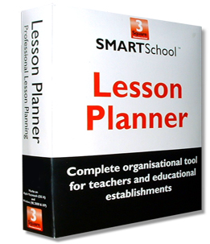
Step Six
Organize the categories into a course time line—which will you teach first, second, third and so on.
www.3squareassociates.com/ Resources/Lesson_PL.

Slide 17

Step Seven
For each category estimate the amount of class time you will need to teach this material—this could be days or weeks
Take each topic under category one and estimate how long you think it will take to teach it.—this is the first step in building a lesson plan
www.cis.gsu.edu/.../ Research/ACIT-APIT/clock.gif

Slide 18
Time Estimates for Lesson Planning
Major Category--The reading process
Topics
Reader’s Health -1 hour
Reading Environment -1hour
Text -2hours
Reader’s Background Knowledge -3hours

Slide 19

Step Eight
For each topic under category one decide what approach you will use to teach this material
Lecture-
The definition of lecture is to talk to students about those ideas, concepts etc. that they cannot learn on their own
ourworld.compuserve.com/.../ g_knott/lecturer.gif

Slide 20

Step Eight
Other Teaching Approaches
Demonstrations
Small or large group discussion
Student presentations
Guest Speakers
Film/video
Field Trips
Students Teaching each Other
www.behaviorresearch.net/ Group%20Discussion.jpg

Slide 21
Context of the Course
Recognize that the Context of the Course will influence these teaching decisions
Number of students
Design of classroom
Role of the course in the curriculum
Number of days per–week it meets
On-Line or face to face or both
Characteristics of the student population-i.e. first-year or fourth year

Slide 22
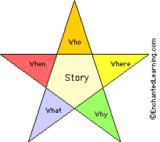
StepNine
Then make a list of what materials you will need to teach this topic
Lecture notes
Picture/image/graphic
Videos/movies
Problems or cases
Physical material
Overheads/Power Points

Slide 23

Step Ten
Next decide what the students will do to learn this material.
Read in advance of the teaching
Read after the teaching
Assignments that follow the teaching
Study for quiz/test
Work in groups
Make presentations
www.fotosearch.com/ comp/BNS/BNS197/UNV013.jpg

Slide 24
Step Eleven
How will you evaluate the students’ learning of this material?
Formative Evaluations—Ways of gaining information about their learning without giving a grade
Class discussions
Individual student questioning
One to one interactions
Classroom Assessment Techniques (CAT’s)

Slide 25
Step Twelve
Summative Evaluations
Quizzes
Tests
Papers
Projects
Presentations
Porfolios

Slide 26
Summative Tools-Ways to evaluated if learning has taken place that are usually graded:
Objective tests, true-false, multiple choice, fill-in-the blanks, matching
Cases or problems
Open book tests
Take home tests
Students make up a test
Oral presentations-power point, transparencies, web pages or sites
Written reports
Written term papers
Written essays
Group presentations
Speeches
Role plays
Performances
Pop Quizzes
Scheduled Quizzes
Essay tests
Simulations
Games, like College Bowl, Jeopardy
Debates
Trials
Point-Counter Point
Town Meeting
Create video or DVD
Interviews
Teach a lesson
Writing case studies
Solving cases or problems
Creating mind maps-content maps
Create images or drawings
Journals
Discussion/participation
Problem sets
Answer questions from readings
Write summary or notes or reading
Puppet Show

Slide 27

Step Thirteen—Criteria for Evaluation
Grading Scale
Rubrics that define the characteristic wanted in the learning
Peers Evaluating each other
Predetermined Standards
National Standards or Licenses

Slide 28
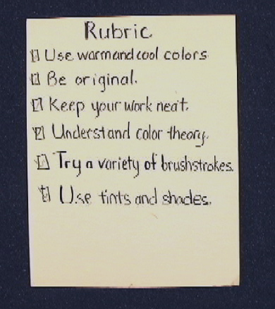
Step Fourteen
How will you give feedback?
Written response
Orally individually or as a group
Rubric with comments
What will you ask the students to do with the feedback?
How will students use the feedback to improve?
ali.apple.com/.../1000085/ files/jpegs/Rubric.JPG

